Slide 1

BlackRock: Pioneering Global Asset Management
BlackRock stands as the world's largest asset manager, revolutionizing financial services with cutting-edge technology and unparalleled expertise. This presentation delves into BlackRock's financial prowess, market position, and future prospects.

Slide 2

Why BlackRock?
Global Leadership
Technology-Driven
BlackRock manages $11.5 trillion in assets, cementing its position as the world's largest asset manager.
The Aladdin platform showcases BlackRock's commitment to innovation in investment management and risk assessment.
Financial Strength
Consistent growth and strong dividends underscore BlackRock's robust financial performance and shareholder value creation.

Slide 3

Overview of BlackRock
Industry
Business Model
Key Financials
BlackRock dominates the financial services and asset management sector, offering a comprehensive suite of investment solutions.
With a market cap of ~$105 billion and $11.5 trillion AUM, BlackRock's financial stature is unparalleled.
The company excels in mutual funds, ETFs, and portfolio management, catering to diverse investor needs.

Slide 4
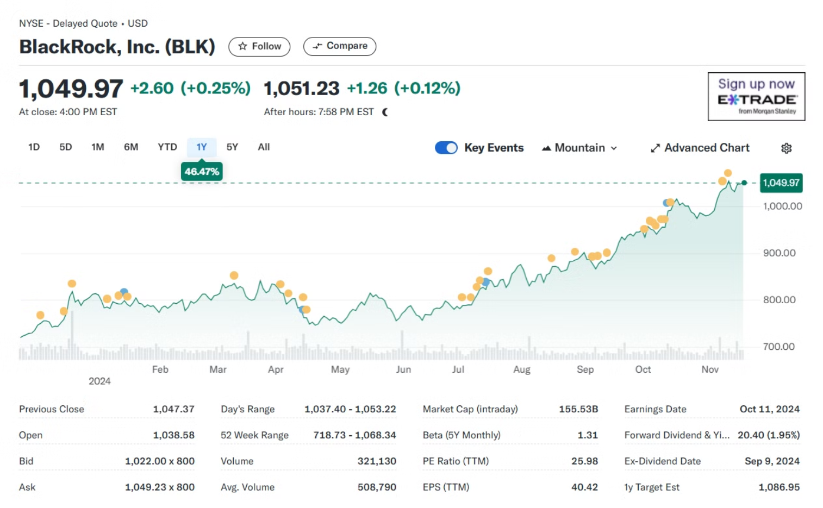

Slide 5




Financial Statement Analysis
Revenue Growth
Profitability
Balance Sheet Strength
Cashflow
BlackRock's revenue growth is consistently strong, driven primarily by increasing demand for their ETF products.
BlackRock maintains high profit margins due to operational efficiency and economies of scale.
BlackRock generates robust operating cashflows, used for growth initiatives and shareholder returns.
A low leverage ratio and strong liquidity position BlackRock for continued growth.

Slide 6
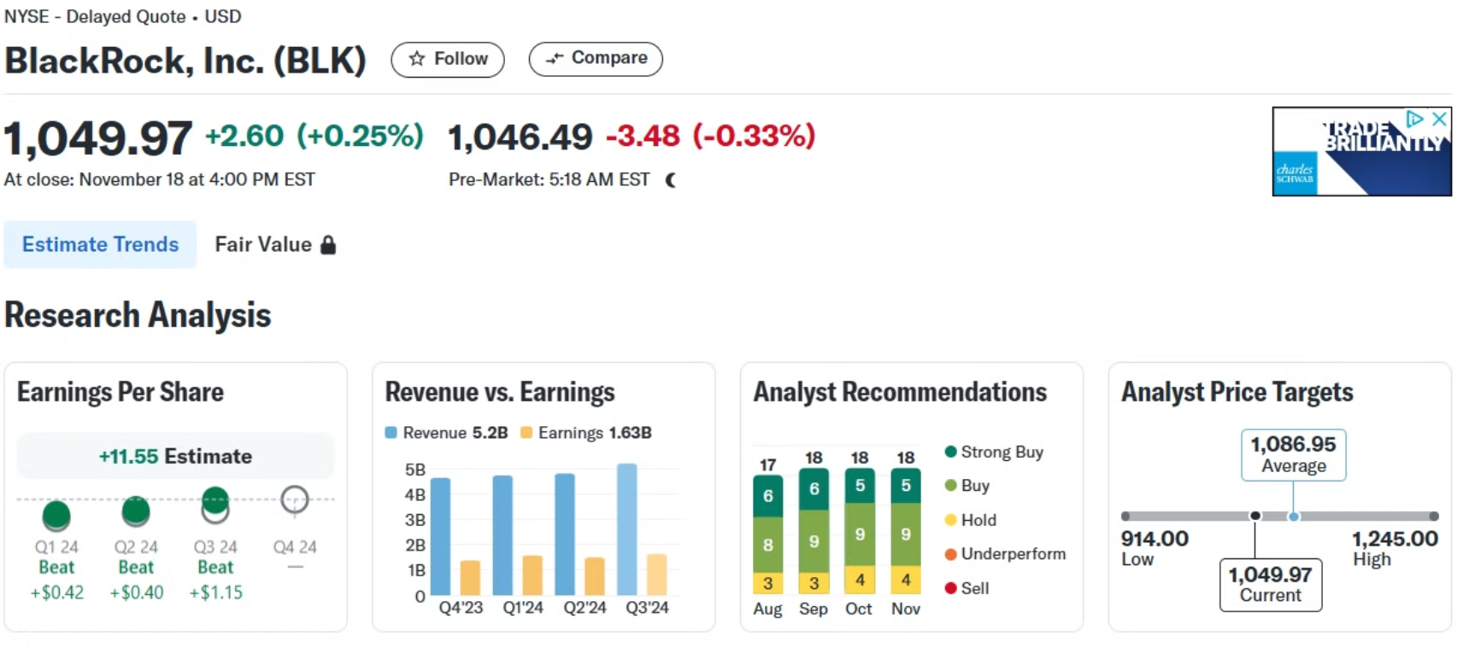

Slide 7

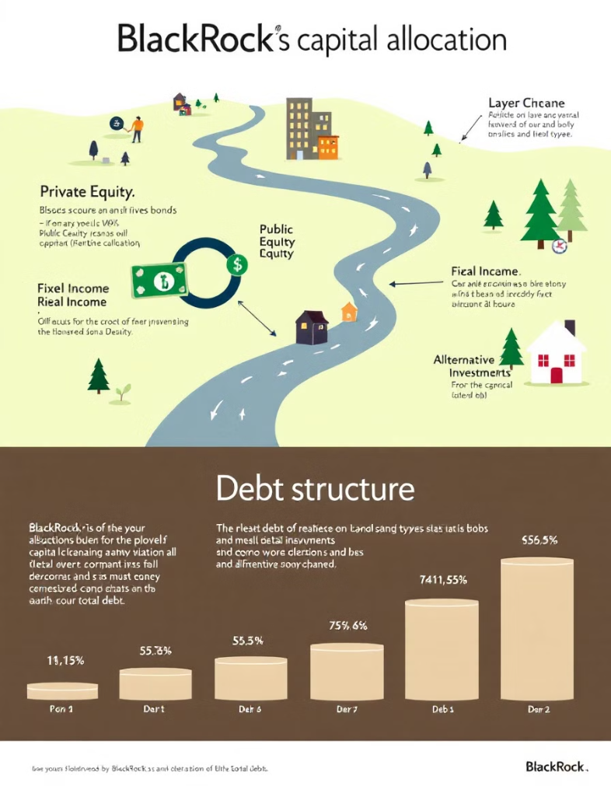
Capital Budgeting and Structure
1
Capital Expenditures
BlackRock strategically invests in expanding its digital platforms, enhancing its technological edge in asset management.
2
Debt Financing
The company maintains a balanced debt profile with a debt-to-equity ratio of ~0.6.
3
Shareholder Returns
BlackRock's commitment to shareholder value is evident through regular dividends and strategic share buybacks.

Slide 8

Competitive Landscape
Company
Market Share
Key Strength
BlackRock
~31% ETF market
Diverse product offerings, including iShares ETFs; advanced risk management platforms like Aladdin.
Vanguard
~29% ETF market
Low-cost index funds and ETFs; strong emphasis on investor education and client services.
State Street
~13.5% ETF market
Expertise in institutional asset management; provider of SPDR ETFs; significant custodial services.

Slide 9
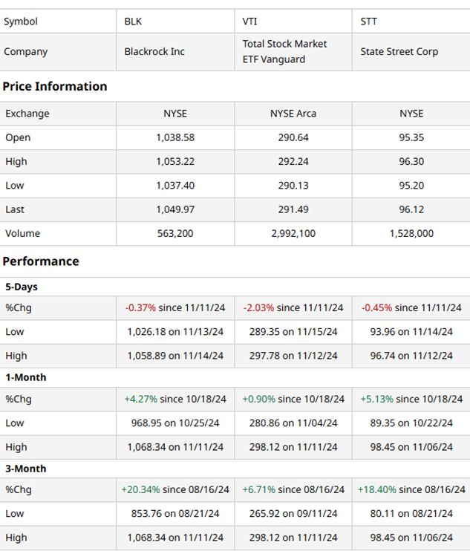
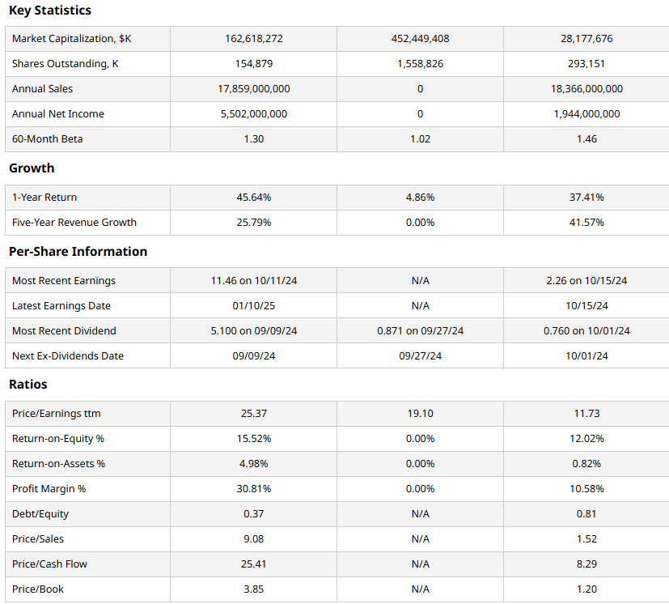

Slide 10
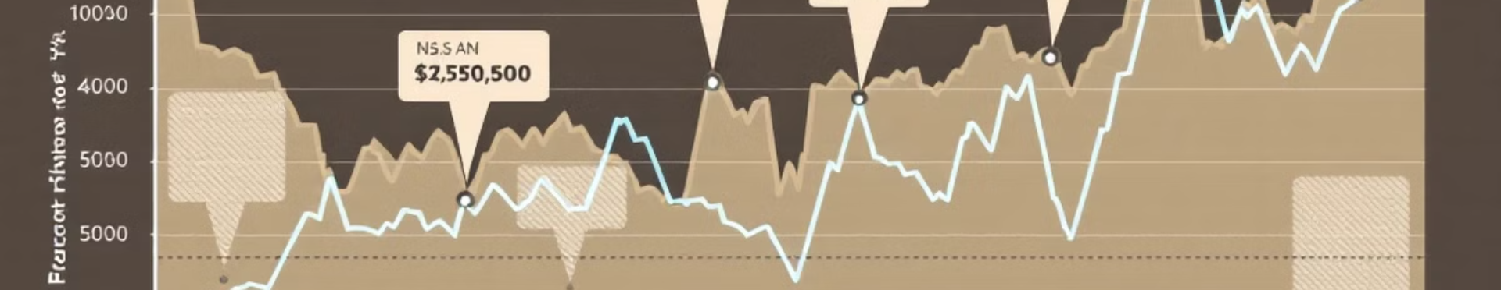



Risk and Return Analysis
Beta: ~1.10
Holding Period Return
Moderate Volatility
BlackRock's beta indicates slightly above-average sensitivity to market movements, reflecting its financial sector exposure and global operations..
A 6-month return of approximately +7% and a 1-year return of +10% showcase consistent performance despite market volatility.
BlackRock's diverse asset base and investment offerings reduce risks and cushion against market fluctuations, ensuring steady returns for investors.

Slide 11
Technological Innovations
1
Data Analytics
2
Automation
3
Digital Platforms
BlackRock's advanced data analytics capabilities enable it to generate valuable insights for clients and drive strategic decision-making.
The firm's investments in automation and AI-powered tools help improve operational efficiency and enhance the client experience.
BlackRock's user-friendly digital platforms provide clients with seamless access to investment solutions and portfolio management tools.
Future Roadmap
Global Expansion
Product Innovation
Continued geographic diversification to capture growth opportunities in emerging markets.
Developing new investment strategies and solutions to meet evolving client needs.
Sustainability Focus
Talent Development
Integrating environmental, social, and governance (ESG) considerations into investment processes.
Investing in employee training and development to maintain a competitive edge.

Slide 12
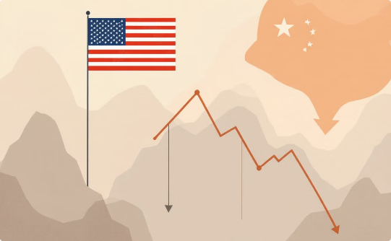
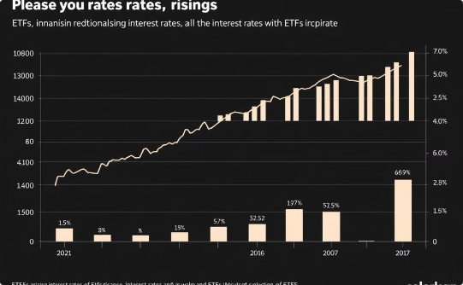
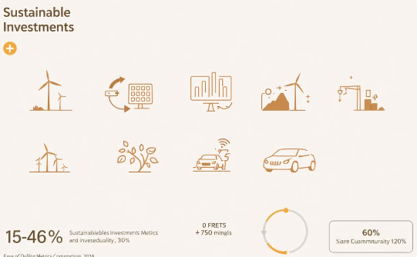
Regulatory and Macro Factors
Geopolitical Tensions
Interest Rates
ESG Trends
US-China relations significantly impact global markets and BlackRock's international investment strategies.
Rising rates present opportunities for BlackRock's fixed-income ETFs and active management strategies.
BlackRock capitalizes on growing demand for sustainable investments, expanding its ESG-focused offerings.

Slide 13
Forecasting BlackRock's Stock Price: Our Approach
This presentation outlines the methodology and key assumptions used to project BlackRock's stock price on November 20th, 2024. We'll detail the data sources, financial models, and market conditions considered in our analysis to provide a well-informed forecast. Transparency and rigor are paramount, so each step of our prediction process will be thoroughly explained.
Assumptions
Goal
1
Predict BlackRock's stock price for November 20, 2024.
2
Model Choices
LSTM and GRU models for capturing short-term trends, supplemented by ARIMA for statistical validation.
Data Used
3
Only recent Close price data from August 15, 2024, to November 15, 2024, with a 90-day sequence length.
Why This Approach?
Short-Term Focus
Noise Reduction
Adaptability
Concentrates on recent trends to enable accurate predictions over a shorter horizon (days or weeks).
Focused solely on Close prices to minimize irrelevant data and improve clarity of the prediction model.
Models trained on the most recent market conditions to align with current trading patterns and investor behavior.

Slide 14
Model Architecture
1
2
Hybrid LSTM-GRU-ARIMA Structure
Hyperparameters
LSTM Layer: Captures sequential dependencies and short-term price patterns.
Learning Rate: Reduced for finer adjustment and convergence.
GRU Layer: Offers computational efficiency and additional validation of sequential data.
Epochs: Adjusted for better learning of recent patterns.
Dropout: Applied to prevent overfitting.
ARIMA: Statistical forecasting for an additional perspective on market direction.

Slide 15
Results and Insights
Predicted Prices for November 20, 2024
Trend Analysis
LSTM: $1026.61
Downward momentum observed based on combined predictions and actual data.
GRU: $1027.87
ARIMA: $1055.73
Python Code link : https://drive.google.com/file/d/1RWlBHSLerjVlqsggeq8tQlgDjpqPpYfO/view?usp=sharing

Slide 16
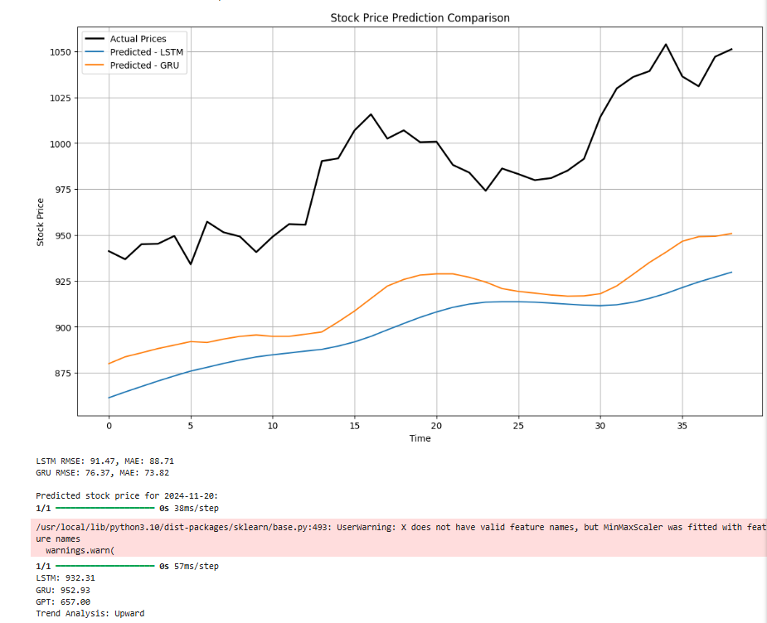
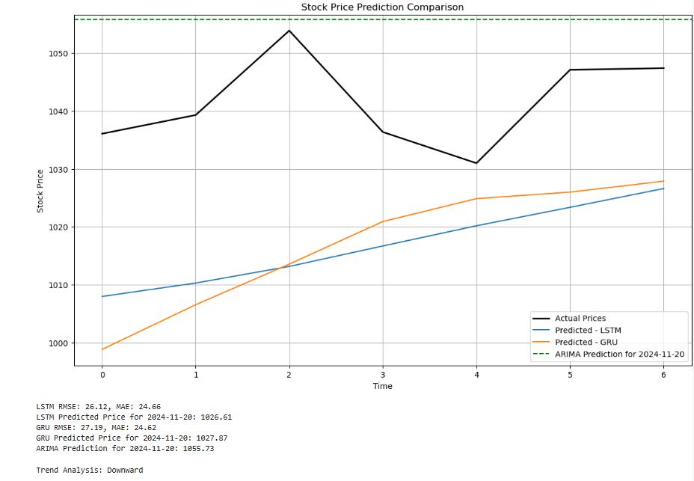
Stock price prediction for November 20 2024

Slide 17
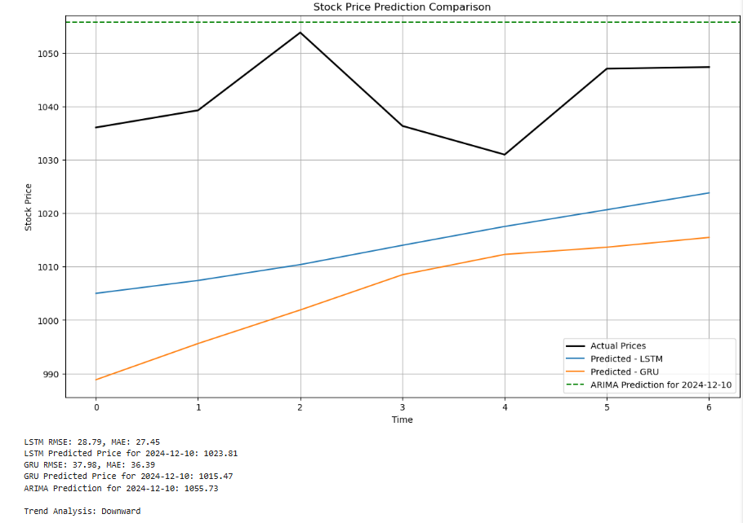
Stock price prediction for December 10 2024

